Slide 1



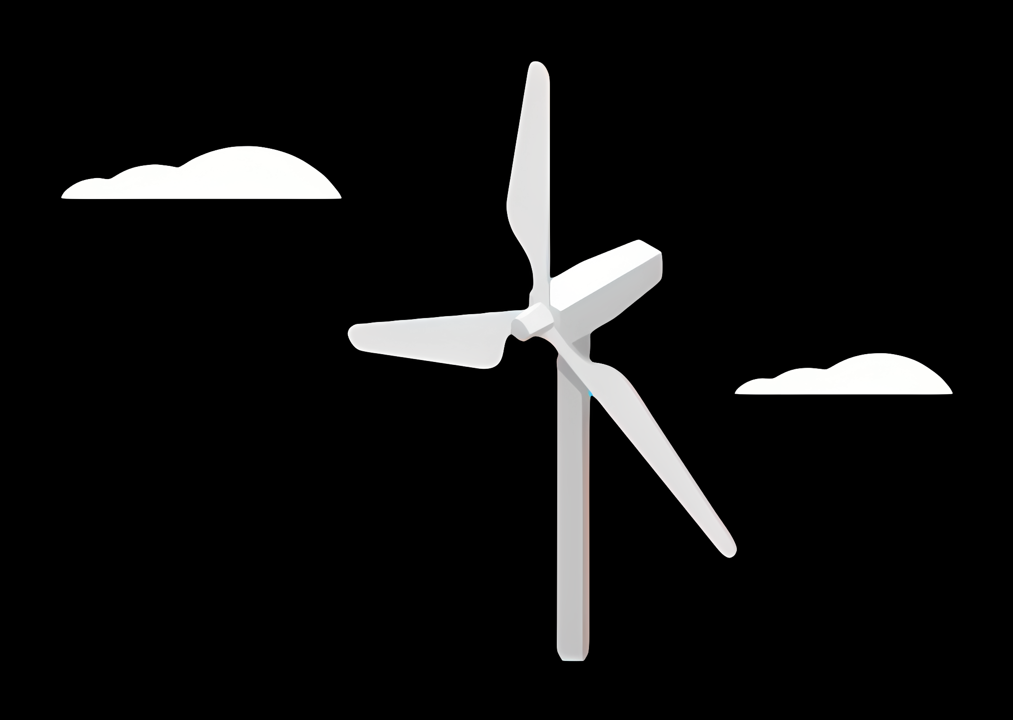
Weekly report: Project management
!
Week number: 01
Date: 27/08/2025
Supervisor: Prof. Quell
These are obviously all examples, feel free to change with your info
Group members: Josef Rememberger, Bakhtyar Sabir Karim, Federico De Mita

Slide 2
Title, example: Tasks of the week
Content
Task one
Task two
Tasks three
…
!
This is an example BUT
an intial slide with all the tasks completed for the week should always be included

Slide 3
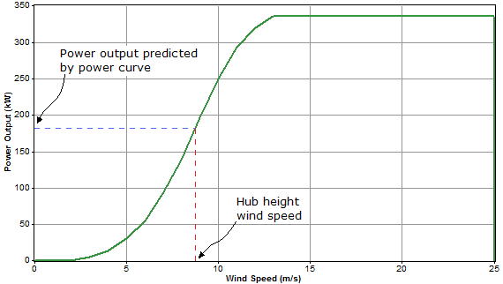
Graph
Add a link to the reference number that goes to the last slide: highlight the number->right click->select link->place in this document->select last slide
(Description of the graph, example: power curve power over wind speed )
(Citation of the sources, example: [1] )
(Last date of access, example: 21/12/2015)

Slide 4
Bibliography
Document sources:
[1] “How HOMER Calculates Wind Turbine Power Output,” Homerenergy.com, 2017. https://www.homerenergy.com/products/pro/docs/3.15/how_homer_calculates_wind_turbine_power_output.html (accessed Aug. 25, 2025).
Source 2:
Source 3:
…
The style chosen for citation is IEEE, so if you want to create your citation follow that style. If you want to create an IEEE citation from a website, you can use some free converters available on the internet, like:
https://www.mybib.com/tools/ieee-citation-generator

